Slide 1














AI Team Assistant
Innovation for workplace
Team Innovation First
Team member:
XIN WANG 221335217
YIFAN CHEN: 222186899
YUCHENG YU: 222479292
Group 19

Slide 2












CONTENTS
01
General Information
05
Impact of the Innovation
02
Benefits of the Innovation
06
Future of the Innovation
03
Technical Information
07
Summary
04
Audience/Users/Customers
08
Reference

Slide 3



General Information
https://www.ypppt.com/
Introduction
There exist only a few applications of AI in team cooperation field. Therefore, we aim to launch an innovation in this field. AI team assistant aims to provide support to team project and prevent potential risk from teams.
Purpose and Goal:
Help teams arrange plans and assign tasks.
Improve the management of team projects.
Reduce the management of team projects.

Slide 4
Working Process
STEP ONE:
STEP THREE:
STEP FIVE:
Offer reasonable suggestions on resource allocation, cost control, risk management and monitoring and alerting.
Review the all things at the end of the project and help to determine the final delivery version.
Receive the detailed outline of the project.
STEP TWO:
STEP FOUR:
Analyze the accepted data to translate it into a concrete implementation plan.
Automatically generate task reports periodically according to the project implementation progress and propose plan changes if the plan is not realized on time.

Slide 5
Benefits of the Innovation
Improve the efficiency
Generate project plan and allocate tasks efficiently.
Track project progress and prevent errors in management.
Identify project problems and bottlenecks.
Decision adjustment and flexibility
Automatically adjust plans based on changes and actual conditions.
Provide advice on resource reallocation and schedule adjustments.
Resource and cost control
Offer the best choices within the budget.
Assign team members and allocate resources effectively.
Risk management and problem warning
Identify project problems and bottlenecks.

Slide 6
Technical information
Server: Provide high-performance computing to handle large-scale data and complex algorithms
Data storage device: Store data and document resources.
Hardware composition
Use TensorFlow or Pytorch for model building.
Use Apache Spark for data processing.
Use Python for algorithm design and use python Matplotlib package for diagram generation.
Use Postman to realize API Integration into the app.
Use Java language to write the basic functions of AI Team Assistant app.
Software composition

Slide 7
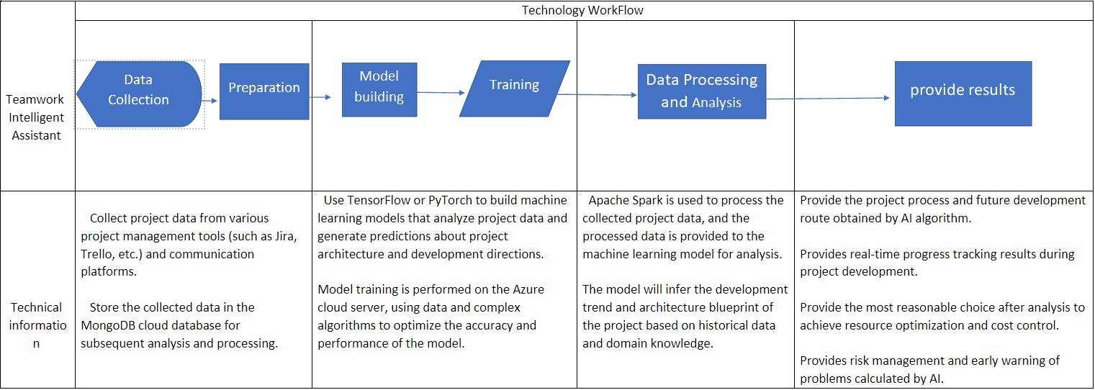
Technology Workflow Sreenshot

Slide 8


Audience/Users/Customers
Student Group
Work can be done more efficiently when student working in one group
90%
70%
Project Management And Team Members
Cross-departmental Team
Make work more quickly when different teams work together and improve the efficiency of information sharing.
Help managers to specify plans and assign tasks more quickly, which enables better teamwork among team members.

Slide 9




Impact of the Innovation
Workplace
Reduce working pressure, save project cost and improve efficiency.
Investment opportunity
Because of the suitability and support for all kinds of team development, it can attract a lot of investment.
Social impact
Provides more job opportunities, improve the social economy and promote the progress of science and technology.

Slide 10
Future of our Innovation
Voice recognition and dialogue functions
More advanced NLP for better sentiment understanding
Cross-platform and cross-device

Slide 11
Summary
The team AI assistant app helps improve the development efficiency of the project and provides better product quality, thus attracting more investment opportunities. Second, the team AI assistant app helps save project costs and make more reasonable use of project resources. Third, the team AI assistant app can help enterprises or government projects develop better and promote social and economic improvement. It is hoped that the team AI assistant app will make project collaboration easier and bring better project results.

Slide 12
Reference
[1]. https://www.mckinsey.com/capabilities/quantumblack/our-insights/the-state-of-ai-in-2022-and-a-half-decade-in-review
[2]. https://www.youtube.com/watch?v=dv9q7Ema40k
[3]. Chakraborti, T., Fadnis, K. P., Talamadupula, K., Dholakia, M., Srivastava, B., Kephart, J. O., & Bellamy, R. K. (2017). Visualizations for an explainable planning agent. arXiv preprint arXiv:1709.04517.
[4]. Marrella, A. Automated Planning for Business Process Management. J Data Semant 8, 79–98 (2019). https://doi.org/10.1007/s13740-018-0096-0
[5]. Aziz, S., Dowling, M. (2019). Machine Learning and AI for Risk Management. In: Lynn, T., Mooney, J., Rosati, P., Cummins, M. (eds) Disrupting Finance. Palgrave Studies in Digital Business & Enabling Technologies. Palgrave Pivot, Cham. https://doi.org/10.1007/978-3-030-02330-0_3
[6]. How Artificial Intelligence Is Transforming Business - businessnewsdaily.com
[7]. Teinemaa, I., Dumas, M., Maggi, F.M., Di Francescomarino, C. (2016). Predictive Business Process Monitoring with Structured and Unstructured Data. In: La Rosa, M., Loos, P., Pastor, O. (eds) Business Process Management. BPM 2016. Lecture Notes in Computer Science(), vol 9850. Springer, Cham. https://doi.org/10.1007/978-3-319-45348-4_23
[8]. The Future of Chatgpt and AI: Trends and Predictions for the Next Decade - WebPrecious
[9]. How AI Is Revolutionizing Project Management: Three Use Cases (forbes.com)
[10]. https://www.ypppt.com/article/2021/8365.html

Slide 13
THANKS FOR WATCHING

